Slide 1
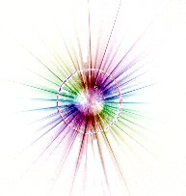

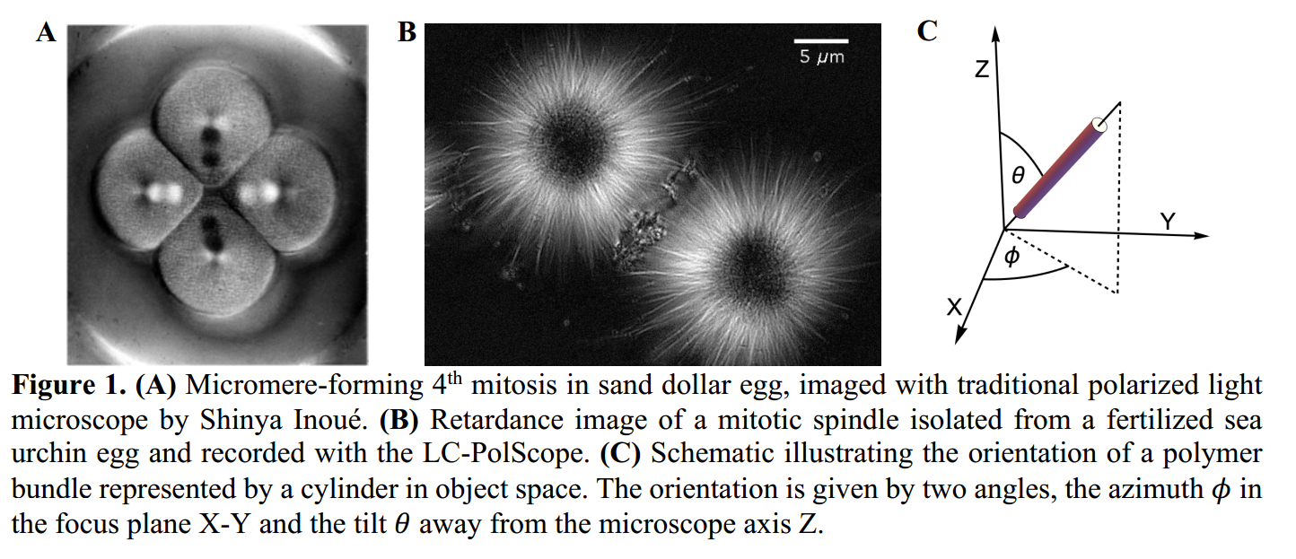
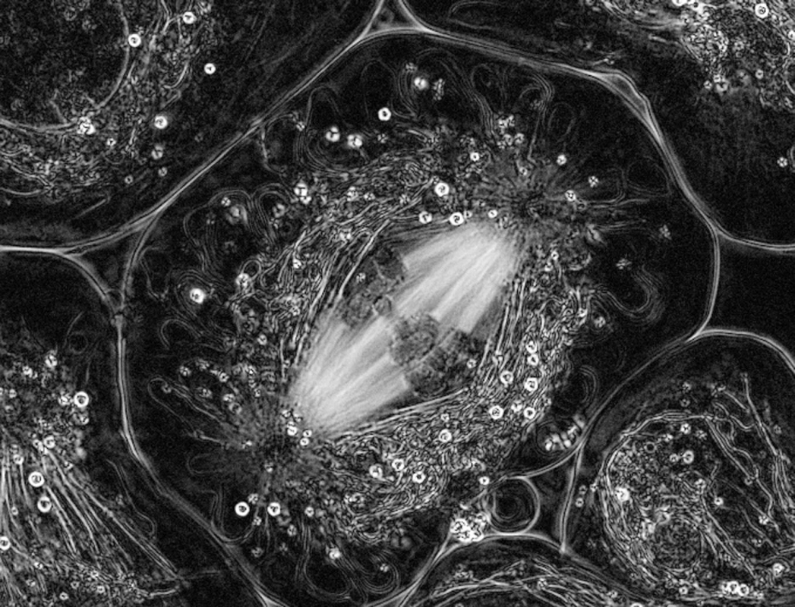
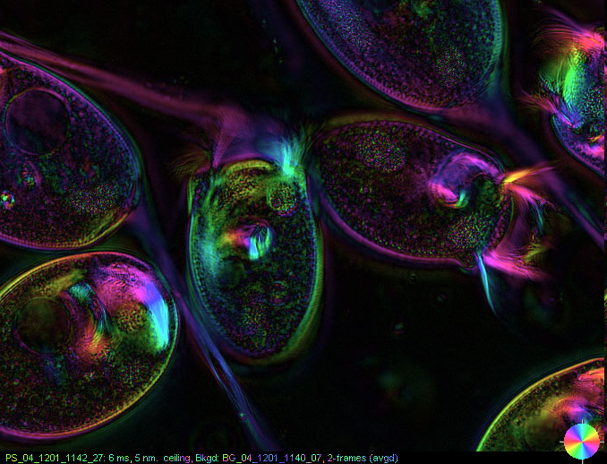
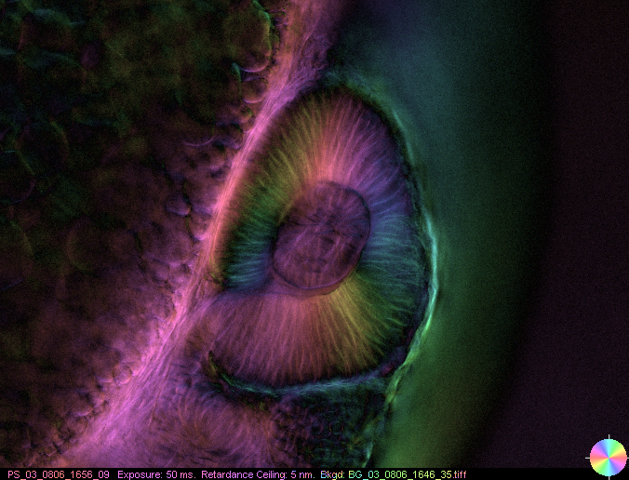
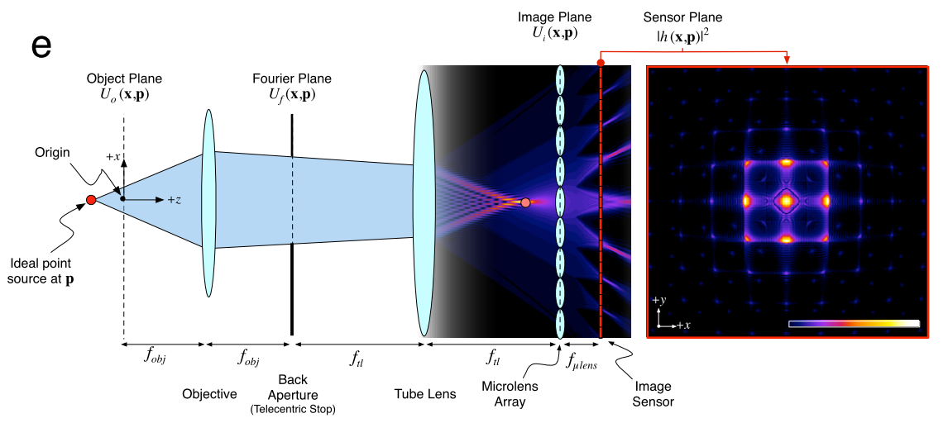
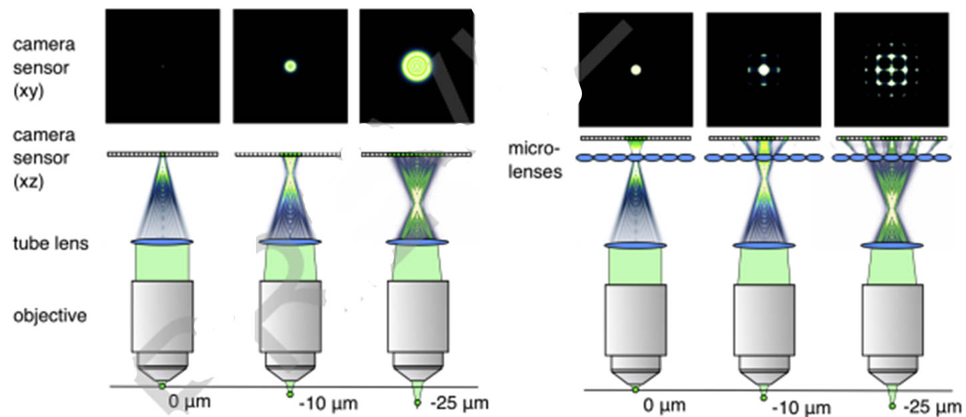
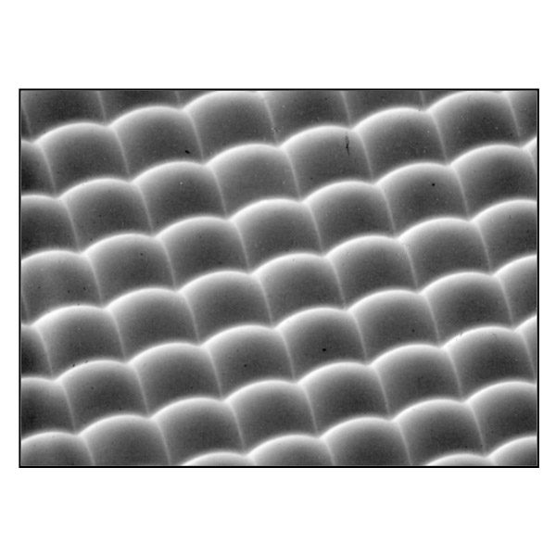
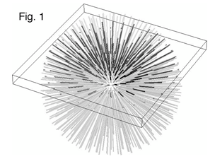
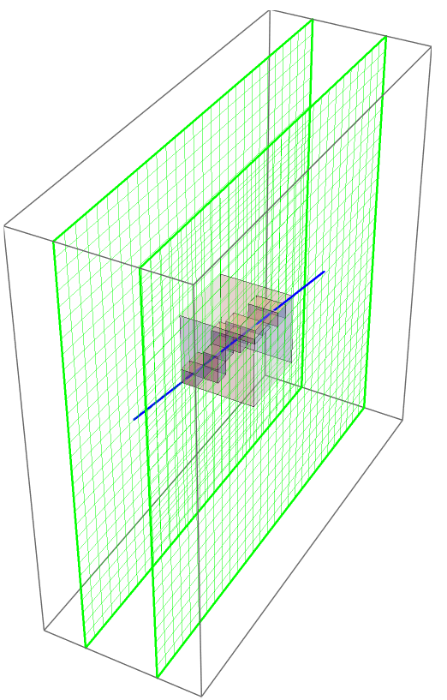
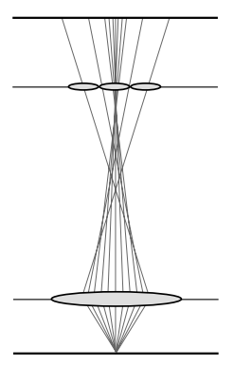
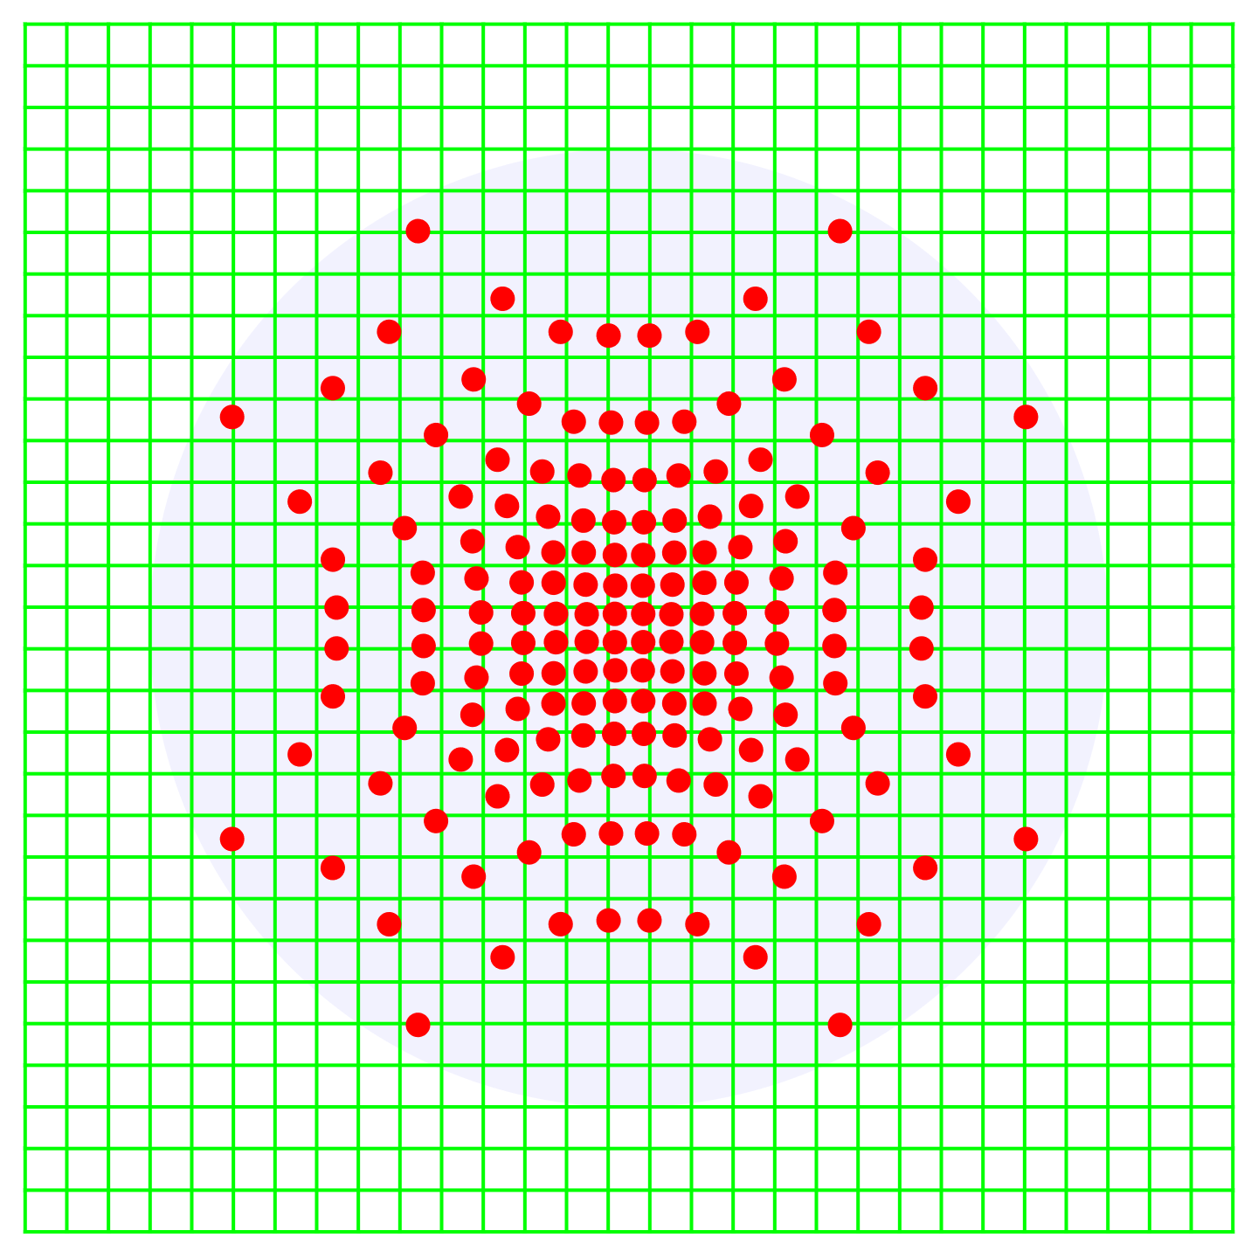
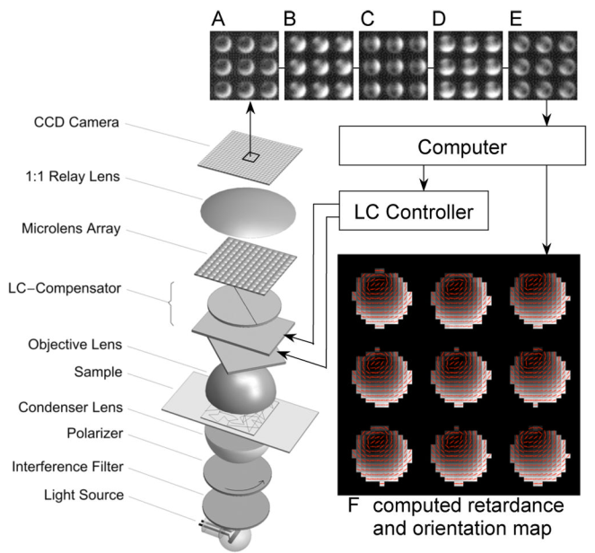
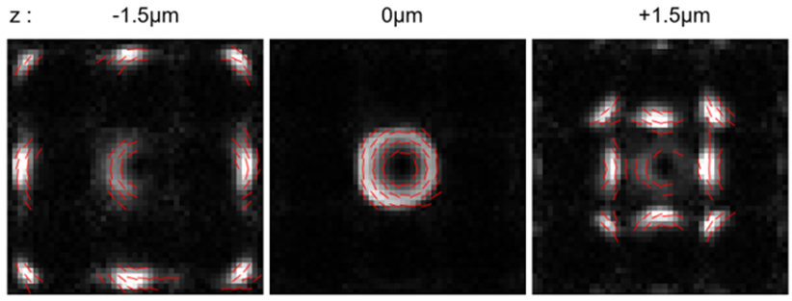
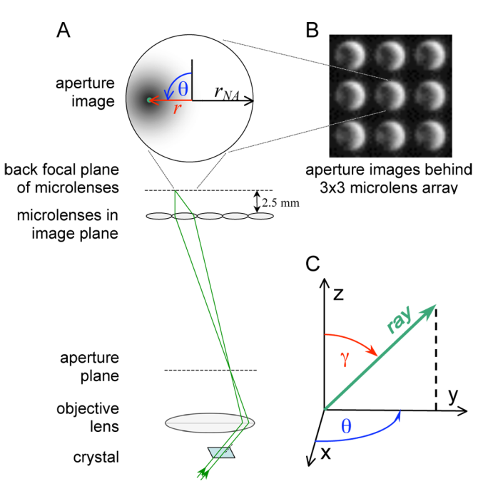
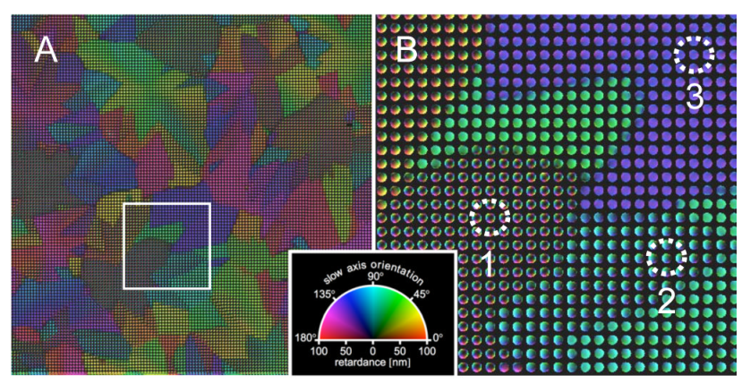
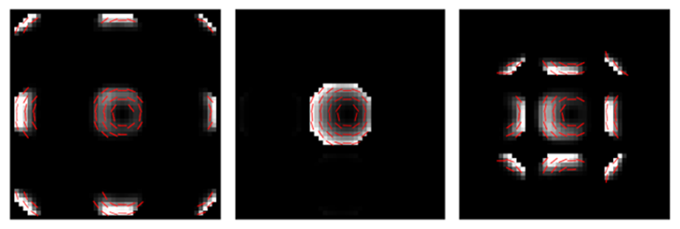
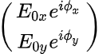
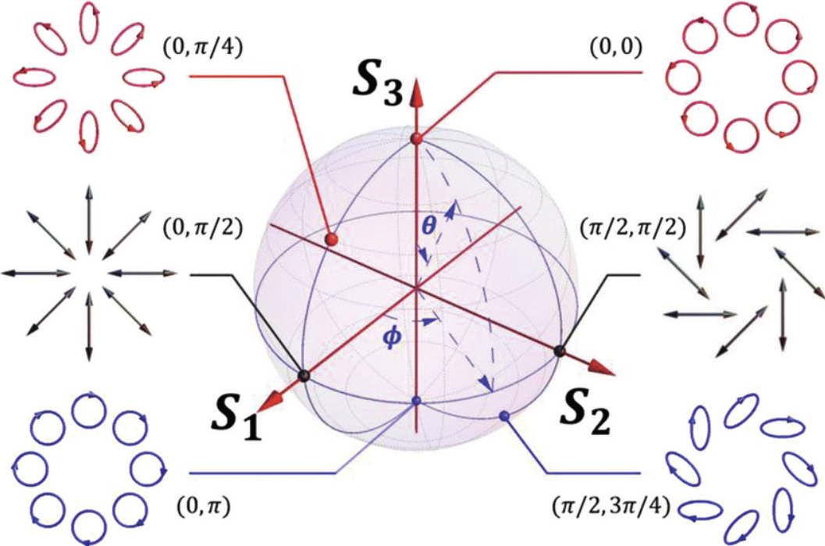
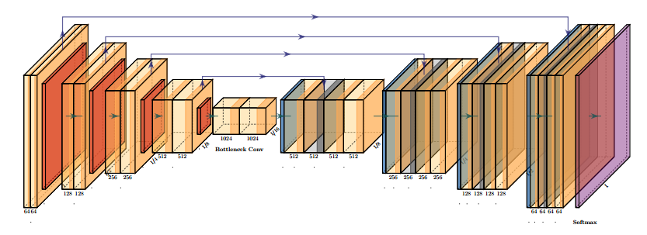
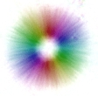
Polarized Light Field Microscopy Using Deep Learning
Grant Harris, Explorative.Engineering
Geneva Schlafly, University of Chicago
Dr. Rudolf Oldenbourg, MBL
Patrick La Viere, University of Chicago
3D birefringence measurements of transparent microscopic volumes
Polarized Light Microscopy
Vari-LC polarization state controller utilizing liquid crystal variable retarders.
Devices and software available from OpenPolScope.org
Birefringence, diattenuation & fluorescence polarization for live cell imaging.
Quantitative (magnitude + orientation) measurement of birefringent structures in living cells such as microtubules, actin, etc.,
Architectural Dynamics of Living Cells Laboratory established by Dr. Shinya Inoue. Dr. Oldenbourg invented the LC-PolScope in 1999. The focus is on the development of instrumentation in collaboration with biological investigators
Light Field Microscopy
Recording and controlling the 4D light field in a microscope using microlens arrays. Levoy M, Zhang Z, McDowall I.J Microsc. 2009
Richardson-Lucy deconvolution
4D light field acquisition using plenoptic camara
Calibration process to rectify geometry and intensity variations before iterative deconvolution for resolution recovery and aberration correction of 3D reconstruction.
microlens array
We are developing a napari plug-in for Light Field Microscopy Imaging
for LFM Reconstruction with iterative and deep learning approaches.
Polarized Light Field Microscopy
Measuring optical anisotropy of uniaxial, non-attenuating samples in 3 dimensions.
Forward Model: Optical Ray Tracing with Jones Calculus
Simulation confirmed with experiment
Acquisition of multiple polarizations (channels), using liquid crystal universal compensator
Object Volume
Optical System
Rays hitting sensor behind
single lenslet
Experimental
We use geometric ray-tracing with optical elements as a series of birefringent voxels, with intersection lengths calculated with the Siddon algorithm.
The process is noncommutative.
Jones vector/ matrix interaction
[Γ, (φ,θ)]
[Γ, (φ,θ)]
Birefringent
element
Simulated
Limited-Angle Tomographic Reconstruction of Birefringence:
Learning the Inverse Transform
Network Architecture: Incorporating Physics and Symmetries
Physics-informed,
train with synthetic data
using forward model
Exploiting Inherent Bias
Deep Priors
Generative adverserial
Variational autoencoders
Exploring how to incorporate known symmetries, group transforms into networks
Convolutional, 2D, 2.5D, 3D, …
Quaternion, Hyper/Complex-valued
Group Equivariant, Spherical, Steerable
Geometric Deep Learning
Graph Convolutional
Polarization Representations
Stokes, Mueller, Jones;
Geometric, Poincare sphere
Group SO(3)/SU(2),
Pauli Algebra,
Quaternion
(See Geneva Schlafly’s poster.)
Γ, (φ,θ)
4D Light Field Image
microlens array
Convolutional neural network
3D Birefringence
Γ: retardance
φ,θ: orientation
2022 Image Science Conference GRC. Emerging Imaging Techniques at the Intersection of Physics and Data Science, June 5 - 10, 2022
Explorative.Engineering

